Slide 1

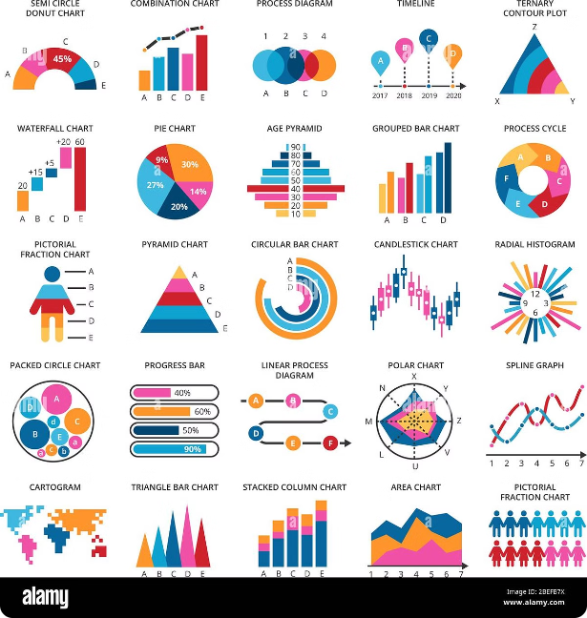

Introduction to Financial Analytics
This presentation provides a comprehensive overview of financial analytics, covering key topics from data collection to insights and recommendations.
by Shivam Sukhadia

Slide 2

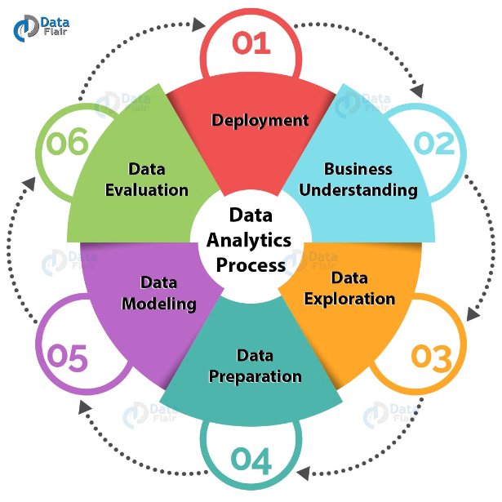
Data Collection and Preprocessing
1
Gathering Data
Collect relevant financial data from various sources like balance sheets, income statements, and market data.
2
Data Cleaning
Ensure data integrity by identifying and addressing missing values, outliers, and inconsistencies.
3
Feature Engineering
Create new variables that provide additional insights and predictive power.

Slide 3

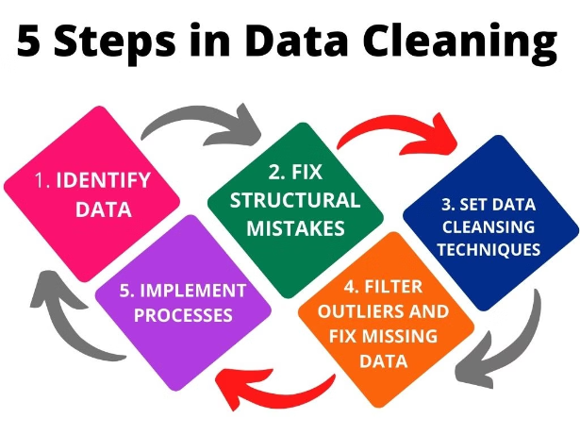
Data Cleaning
1
Handling Missing Values
Utilize techniques like mean/median imputation, kNN imputation, or advanced methods to fill in missing data.
2
Removing Outliers
Identify and remove or mitigate the impact of outliers that could skew the analysis.
3
Data Normalization
Ensure data is on a common scale by applying techniques like standardization or min-max scaling.
4
Dealing with Multicollinearity
Address highly correlated variables that could lead to unstable model performance.

Slide 4
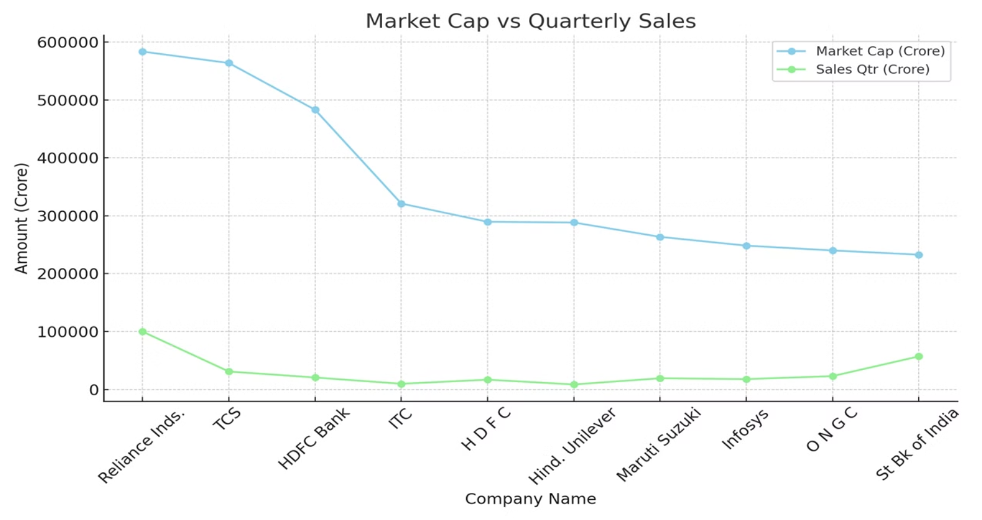
Financial Ratio Analysis

Slide 5

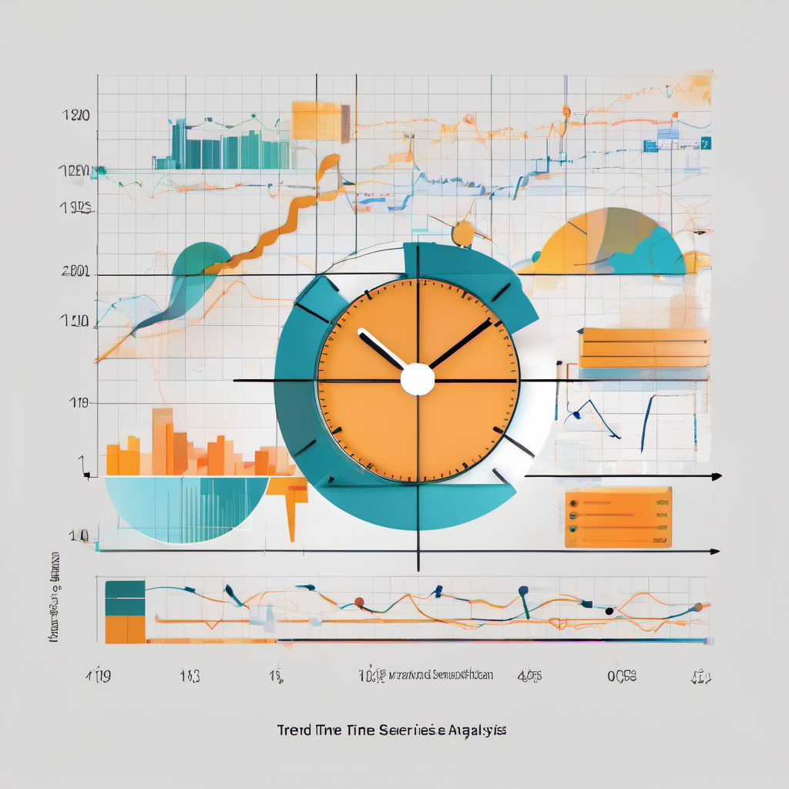
Trend and Time-Series Analysis
1
Trend Analysis
Identify long-term patterns and trajectories in financial metrics like revenue, expenses, and profitability.
2
Seasonality
Detect and account for any seasonal fluctuations in the data, such as quarterly or annual cycles.
3
Forecasting
Use time-series models to predict future financial performance based on historical trends and patterns.

Slide 6
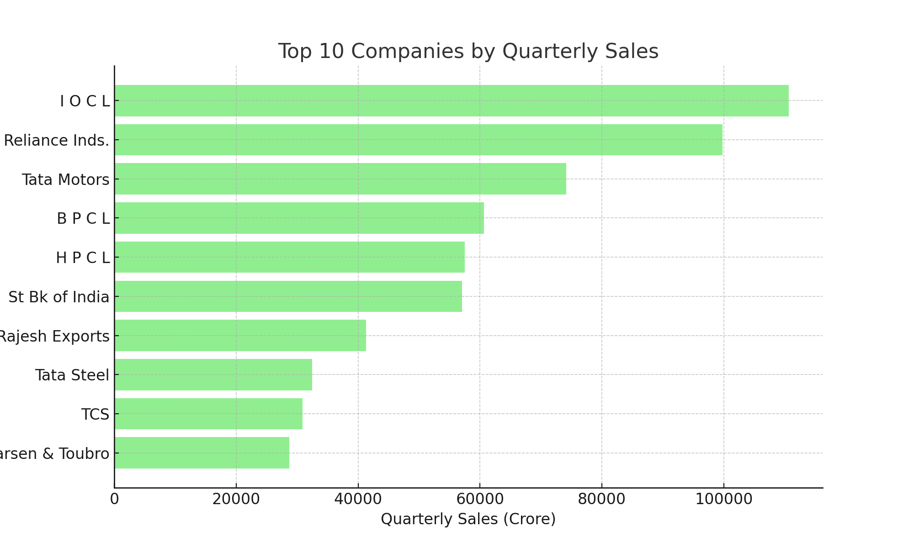
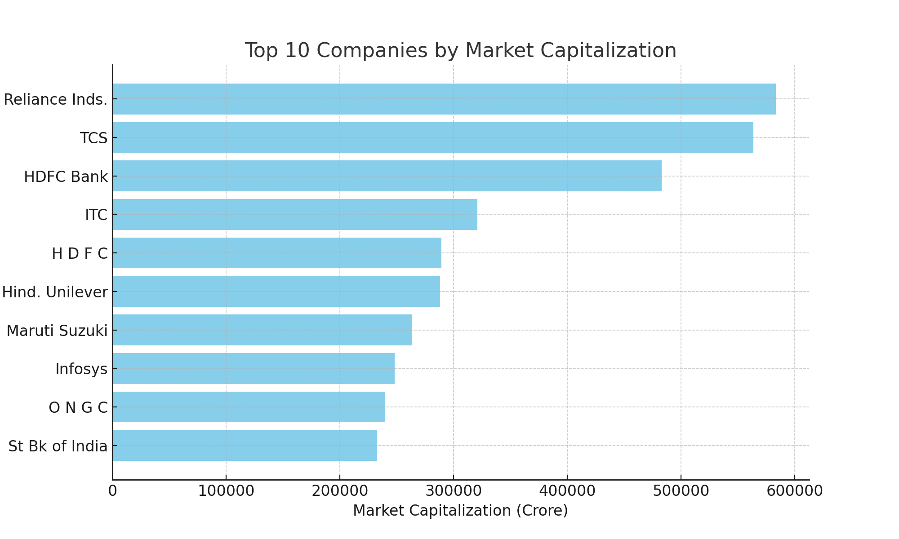
Visualization and Reporting

Slide 7

Insights
Competitive Benchmarking
Risk Identification
Analyze how the company's financial performance compares to industry peers and best-in-class competitors.
Uncover potential risks and vulnerabilities that could impact the company's financial stability and growth.
Strategic Opportunities
Data-Driven Decisions
Identify areas for improvement and opportunities to enhance profitability, operational efficiency, and shareholder value.
Provide fact-based recommendations to guide strategic decision-making and ensure long-term financial sustainability.

Slide 8


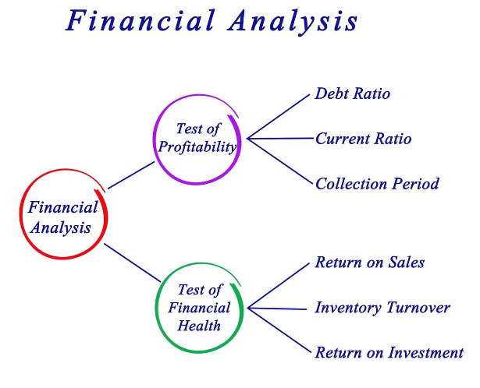


Conclusion and Key Takeaways
Key Insights
Summarize the critical insights and findings from the financial analysis.
Strategic Recommendations
Provide actionable recommendations to drive business growth and financial performance.
Future Outlook
Discuss how the company can leverage financial analytics to navigate future challenges and capitalize on emerging opportunities.

